Slide 1
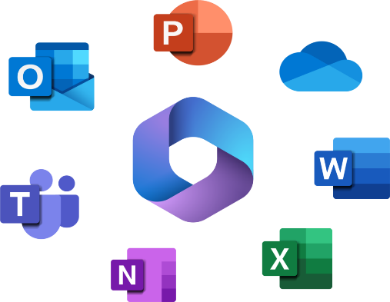

Getting Started with Windows & Microsoft 365
Chapter 4

Slide 2

LEARNING OUTCOMES
By the end of this session, students should be able to;
  Desktop Interface
  Basic Navigational
  Finding Settings
  Locating Applications
  File Management
  How do I log into Windows 11?
  How do I shutdown Windows 11?
  Starting a Microsoft 365 Application
  Using the file menu/backstage view
  Using the context menus
  Using the mini toolbar
  Using Office Help

Slide 3
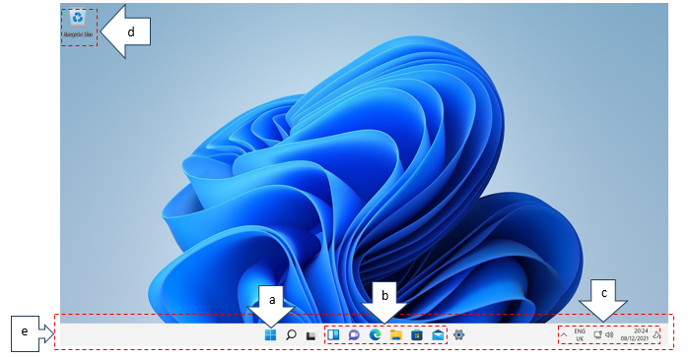
Desktop Interface
Use the Start Menu (a) by clicking the Start button or pressing the Windows key on your keyboard. The search bar (b) helps you find apps, files, or settings quickly. Task View (Windows + Tab) (c) shows open windows and virtual desktops.
Figure 5.1: Window 11 Desktop

Slide 4
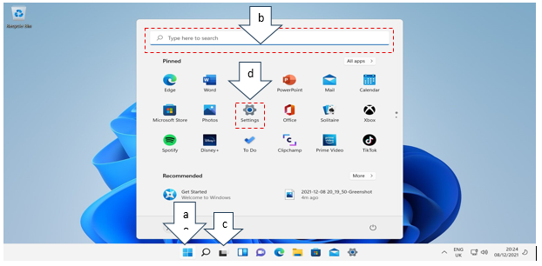
Basic Navigation
When you log in to Windows 11, the first thing you see is the desktop as shown in the figure below. It includes a centered taskbar (e) with the Start button (a), pinned apps (b), and a system tray showing clock, volume, and network (c). Icons on the desktop (d) provide quick access to files and apps.
Figure 5.2: Windows 11 Basic Navigation

Slide 5
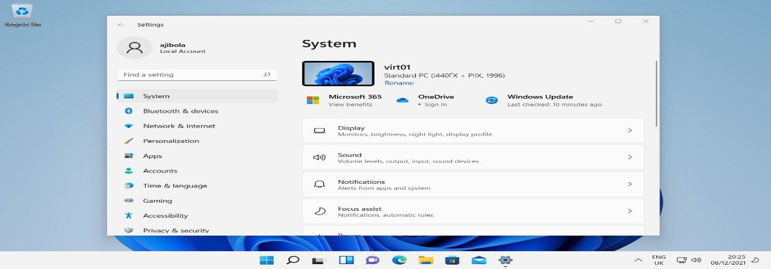
Finding Settings
Open Settings by clicking Start / Settings (gear icon) (d) or pressing Windows + I. Common sections include System (display, sound), Accounts (sign-in options), Update & Security, and Privacy & Security.
Figure 5.3: Windows 11 settings

Slide 6
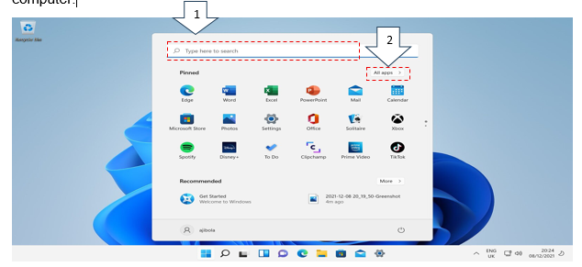
Locating Applications
Two methods of locating applications.
Use the Start Menu or Search Bar to find apps.
Inside the start menu click the All-Apps list to show everything installed on the computer
Figure 5.4: Windows 11 locating applications

Slide 7
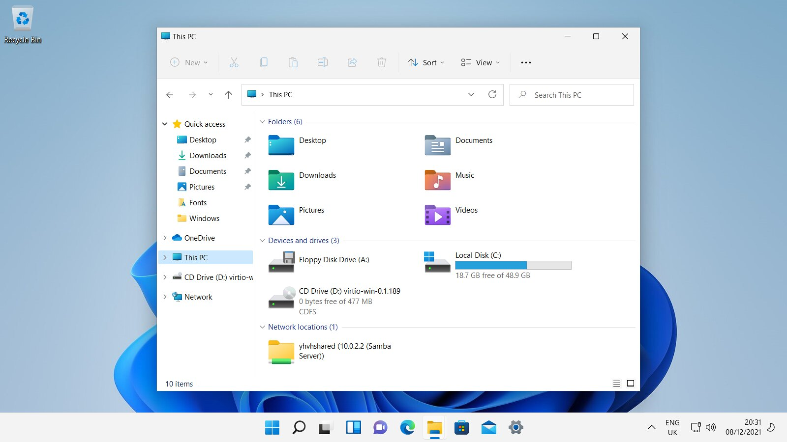
File Management
File Explorer, which is the yellow folder icon on the taskbar, helps navigate drives, folders, and files. Open it via Start Menu or Windows + E. File Explorer helps you create folders, copy/move files using drag-and-drop or shortcuts (Ctrl + C / Ctrl + V). Quick Access shows frequently used folders.
Figure 5.5: Windows 11 File Explorer

Slide 8
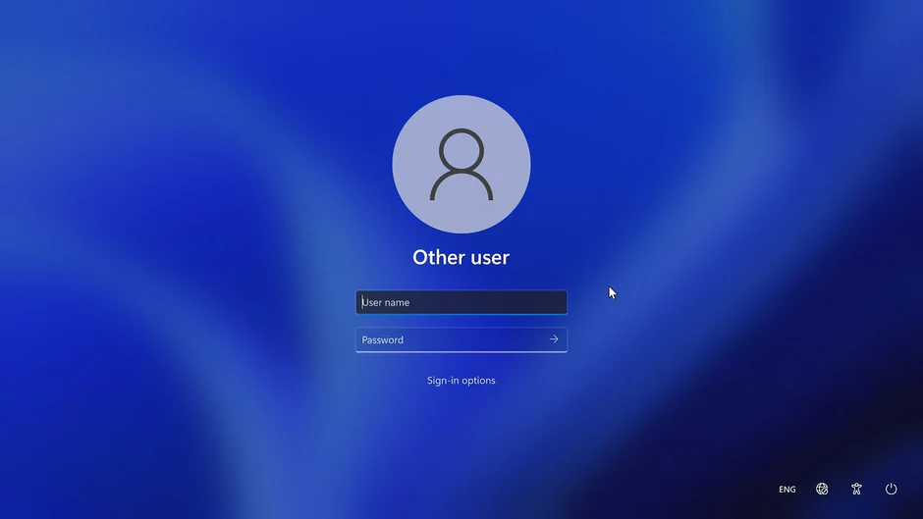
How do I log into Windows 11?
Windows 11 supports Password, PIN, and Windows Hello (facial recognition or fingerprint). As shown in figure below, type your username and password in the fields then click the login button or hit enter on your keyboard to access your computer.
Figure 5.6: Windows 11 Login Screen

Slide 9
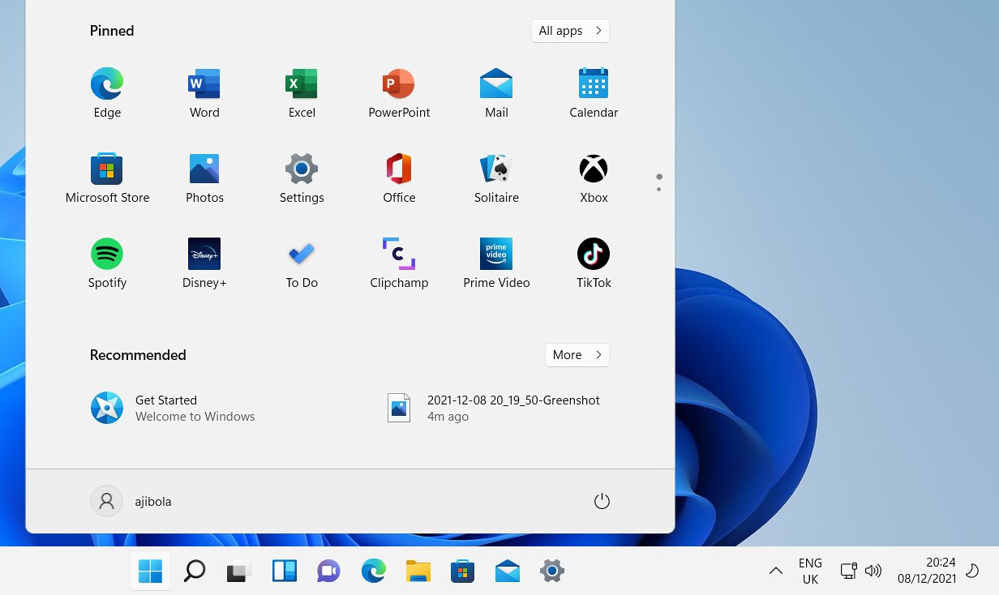
How to Shutdown Windows 11?
Click Start / Power button to access Shut down, Restart, and Sleep options.
Figure 5.7: Windows 11 Shutdown options

Slide 10
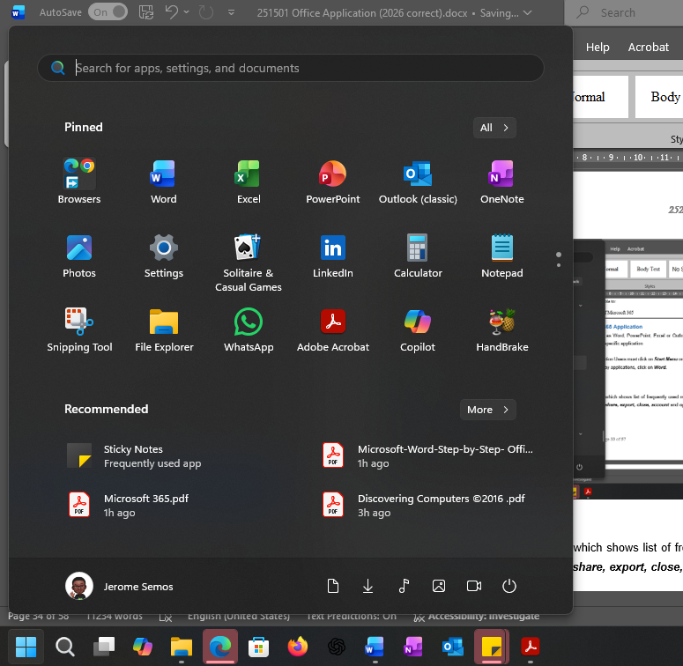
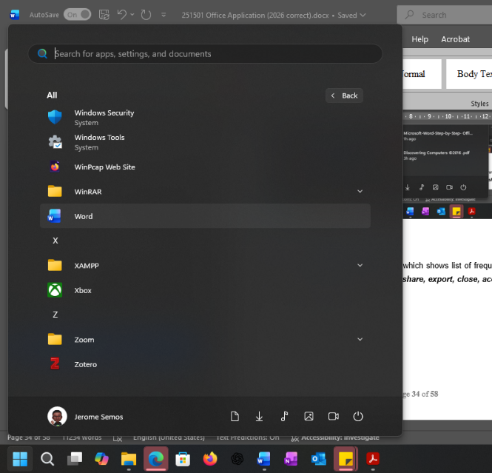
Starting a Microsoft 365 Application
For all Microsoft 365 applications such as Word, PowerPoint, Excel or Outlook the user must first launch it by opening the specific application on their computer.
For example, to open Word office application Users must click on Start Menu on the Task bar, then click on All Programs to display applications, and click on Word.
Figure 5.8: shows how to start the Microsoft 365 Application

Slide 11
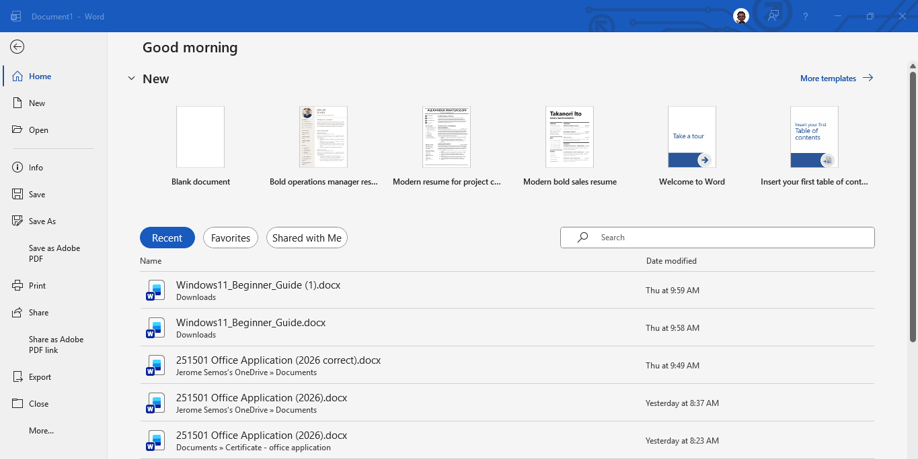
Using the file menu/back view
The File Menu displays backstage view which shows list of frequently used menus like home, new, open, info, save, save as, print, share, export, close, account and options.
Figure 5.9: Word 365 Backstage view

Slide 12
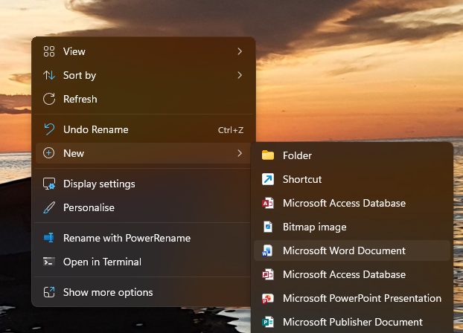
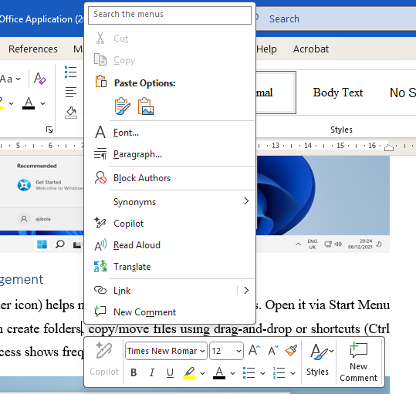
Using the context menu
The context menu is displayed when the user right-clicks on an item in Windows. It displays list of items on a selected file or an object. It is also referred to as short-cut menus.
Figure 5.10: Examples of context menus

Slide 13

Using the Mini Tool bar
Mini Tool bar adds functionality to your word processing especially when formatting your document. It is a version of all the commands found in Font group. The mini tool bar appears when user highlights a text or right click text. It makes it convenient for a user to apply formatting features without having to drag mouse over to the ribbon to select commands on Font group. The user can turn the mini tool bar off by clicking File / Options / General. Clear the Show Mini Toolbar on selection check box. Click OK.
Figure 5.11: Mini toolbar

Slide 14
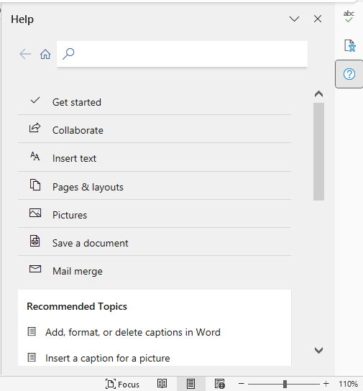
Using Office Help
Office Help is an important feature that provides many related word topics that a user may find very helpful. It functions like web browser window where the user simply clicks on a topic that has a link and it opens displaying more additional related information. The user can also type a topic in a search for text box to display more content of a topic. Users can also press F1 function key to open the Help window. Type word related topics in the search for text box, for example, type Page break and it will display topics related to Page break as shown below.
Figure 5.12: Word 365 Help feature

Slide 15
Review Activities:
There are different ways to open Microsoft Word documents. Write the steps for each one of them.
What is the mini toolbar?
Explain the function of Word Help feature.
What are the main components of the Windows 11 desktop interface?
How do you open the Start Menu and search for an application in Windows 11?.
Which shortcut opens File Explorer in Windows 11?
Describe two actions you can perform in File Explorer to manage files.
How do you locate Microsoft Word and open it in Windows 11?
What are the steps to shut down your computer safely in Windows 11?
Which keyboard shortcut opens the Start Menu?
What is the shortcut to open File Explorer?
Which shortcut locks your computer screen?
How do you quickly open the Settings app using a shortcut?
What is the shortcut to minimize all open windows?
Which shortcut opens Task View to manage virtual desktops?

Slide 16
Practical Exercises
Read through the lecture and login to computer and get started with Windows and Microsoft 365

Slide 17
Thank you !!

